Slide 1


The Effect of Walking Speed, Slopes, and Stairs on Dynamic Mean Ankle Moment Arm
K. Heidi Fehr^{1*}, Jenny A. Kent², Jasmine Nakum¹, Matthew J. Major^{2,3}, and Peter Gabriel Adamczyk¹
¹University of Wisconsin-Madison, Madison WI, USA, ² Northwestern University Prosthetics-Orthotics Center, Feinberg School of Medicine, Northwestern University, Chicago IL, USA , ³Jesse Brown VA Medical Center, Chicago, USA

Slide 2
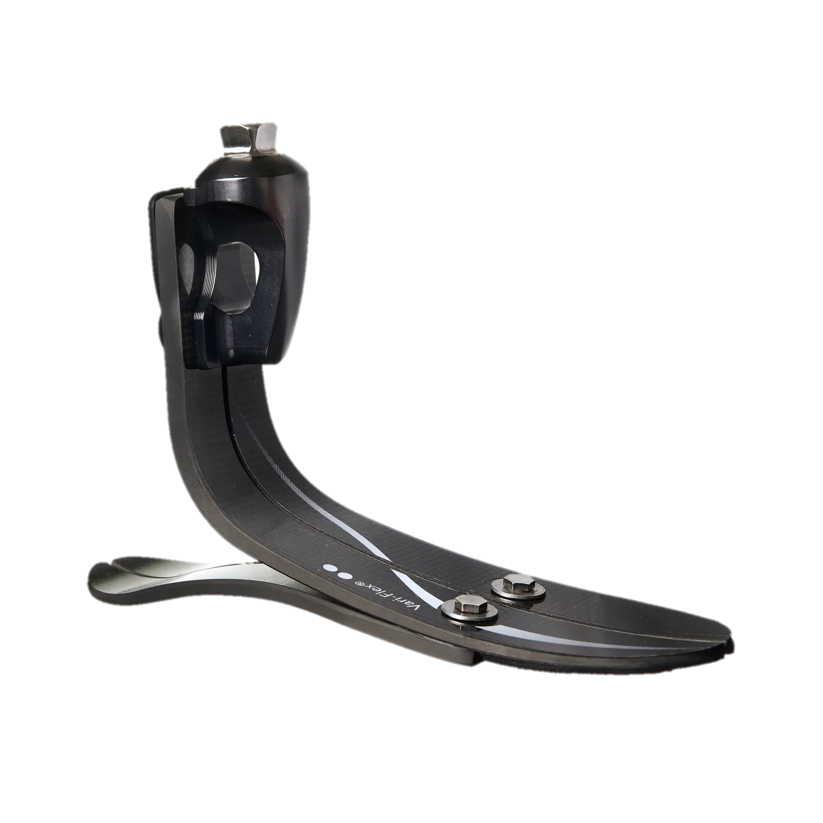
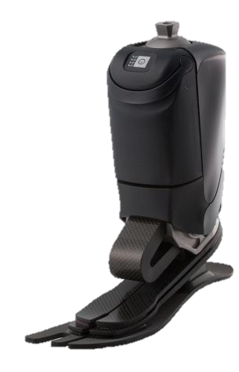
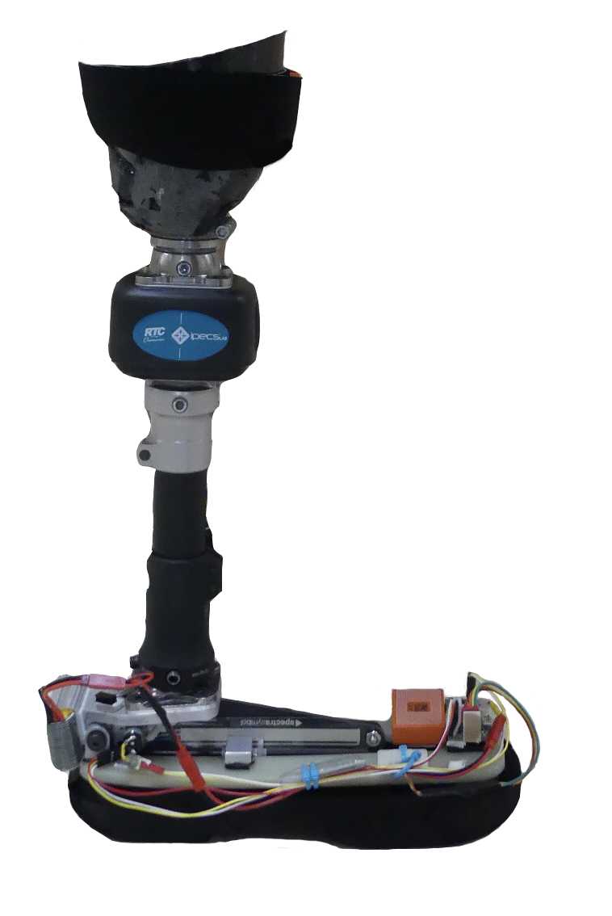
Prosthetic Foot Control
Passive
Semi-Active
Active
(fully robotic)
adjusts stiffness once per stride
Vari-Flex® by Össur
Variable Stiffness Foot (VSF)
Empower® by Ottobock
What is a suitable target control metric?
Notes:
Prosthetic feet can be categorized into three main types: Passive which have no electronic components and essentially work as a spring and damper system. Based on their design they have a fixed stiffness that can’t adapt to different walking conditions like walking on ramps or stairs. There are also active which are fully robotic and have the ability provide mechanical power during the gait cycle (such as during push of) These usually offer some adaptation to different terrains and they can adapt all throughout the gait cycle. Finally, what I’m focusing on today are semi-active prostheses. In order to have lowered complexity and weight these prostheses only adjust once per stride. For example, here we have the variable stiffness foot adjusts forefoot stiffness once per stride when the foot is in the air.
The foot has a fulcrum shown here that moves either forward or back in order to make the foot more or less compliant.
Now, if we want to control a semi-active prosthesis to adapt to different terrains, it’s important to select an appropriate target metric.

Slide 3
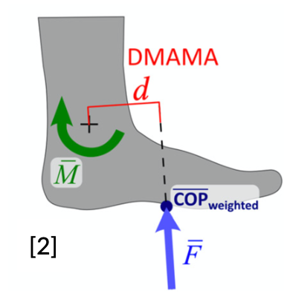
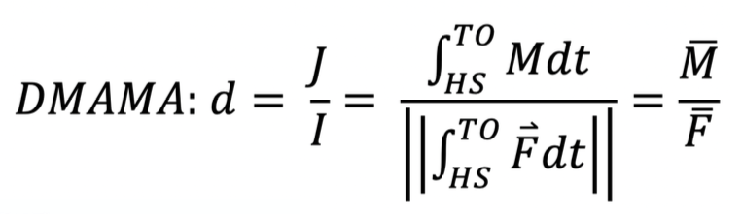
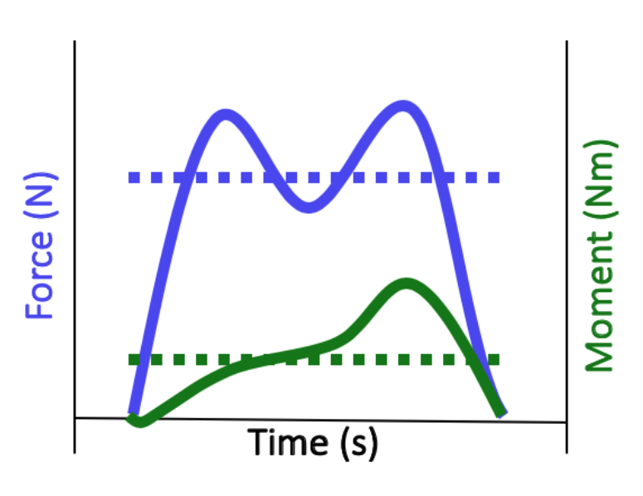
Dynamic Mean Ankle Moment Arm (DMAMA)
Single value per stride!
Notes:
In this study we are exploring the DMAMA metric. DMAMA is a single number per stride that describes how the ankle controls the location of force interaction.
In it’s calculation you can see that it is driven by the angular impulse about the ankle which is influenced by things such as the amount of time the foot is in contact with the ground (walking speed) and how high the forces are during that time. This can give you an idea if the walk was maybe very bouncy or smooth. This is then normalized by the impulse of the sagittal ground reaction force. Functionally we calculated it quite simply by dividing the mean ankle moment by the mean sagittal ground reaction force. The result is a single value per stride.

Slide 4
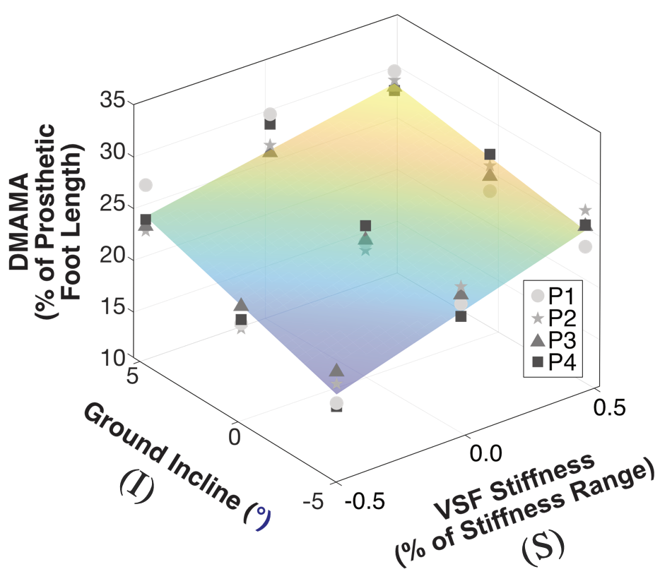
Previous Work with VSF
Variable Stiffness Foot (VSF)
Stiffness
Ground Incline
What should we set DMAMA to?
Notes:
In our previous work we looked at if and how DMAMA would change with different stiffness settings in the VSF and over different ground inclines in transtibial amputees. We saw that changing the stiffness and ground incline did influence DMAMA and that it increased with both stiffness and ground incline.
This leads us to the motivation for this particular study: if we were to actively try to control DMAMA, what value would we set it to?

Slide 5
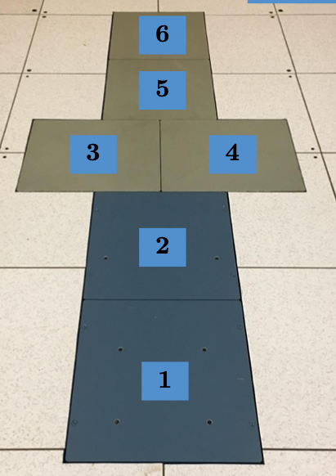
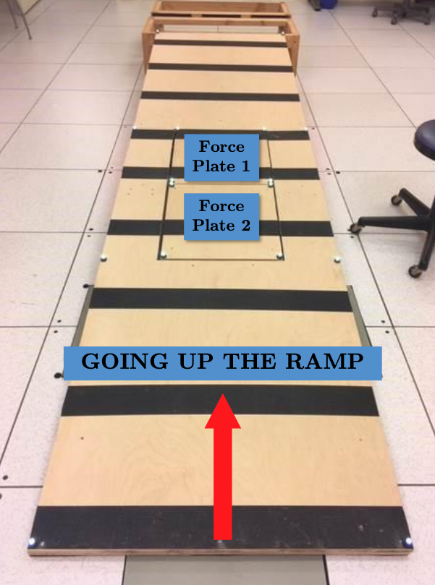
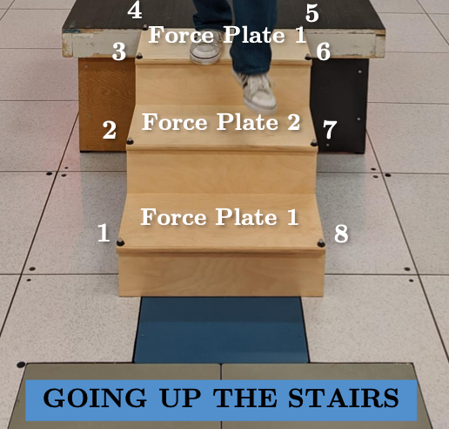



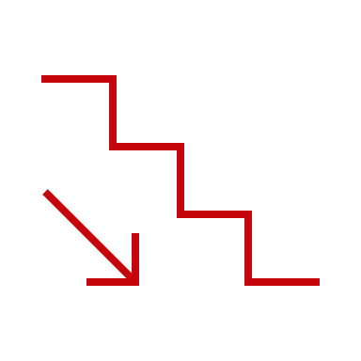
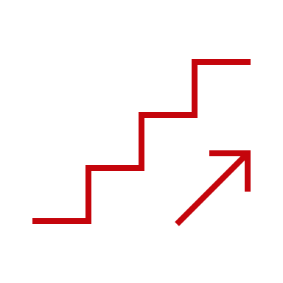



Our Study
How does DMAMA change in unimpaired, non-disabled participants?
3D-Motion Capture & Surface Embedded Force Plates
Notes:
To find this out, we asked: How does DMAMA change in unimpaired people? Using motion capture and embedded force plates we observed the gait in 10 unimpaired individuals as they: walked over level ground at different speeds, (slow normal and fast), as they ascended and descended a 5-degree incline, and ascended and descended stairs.

Slide 6

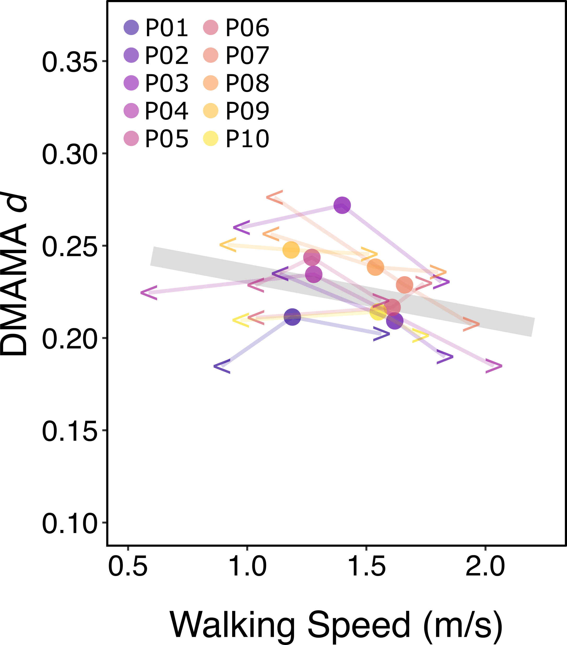
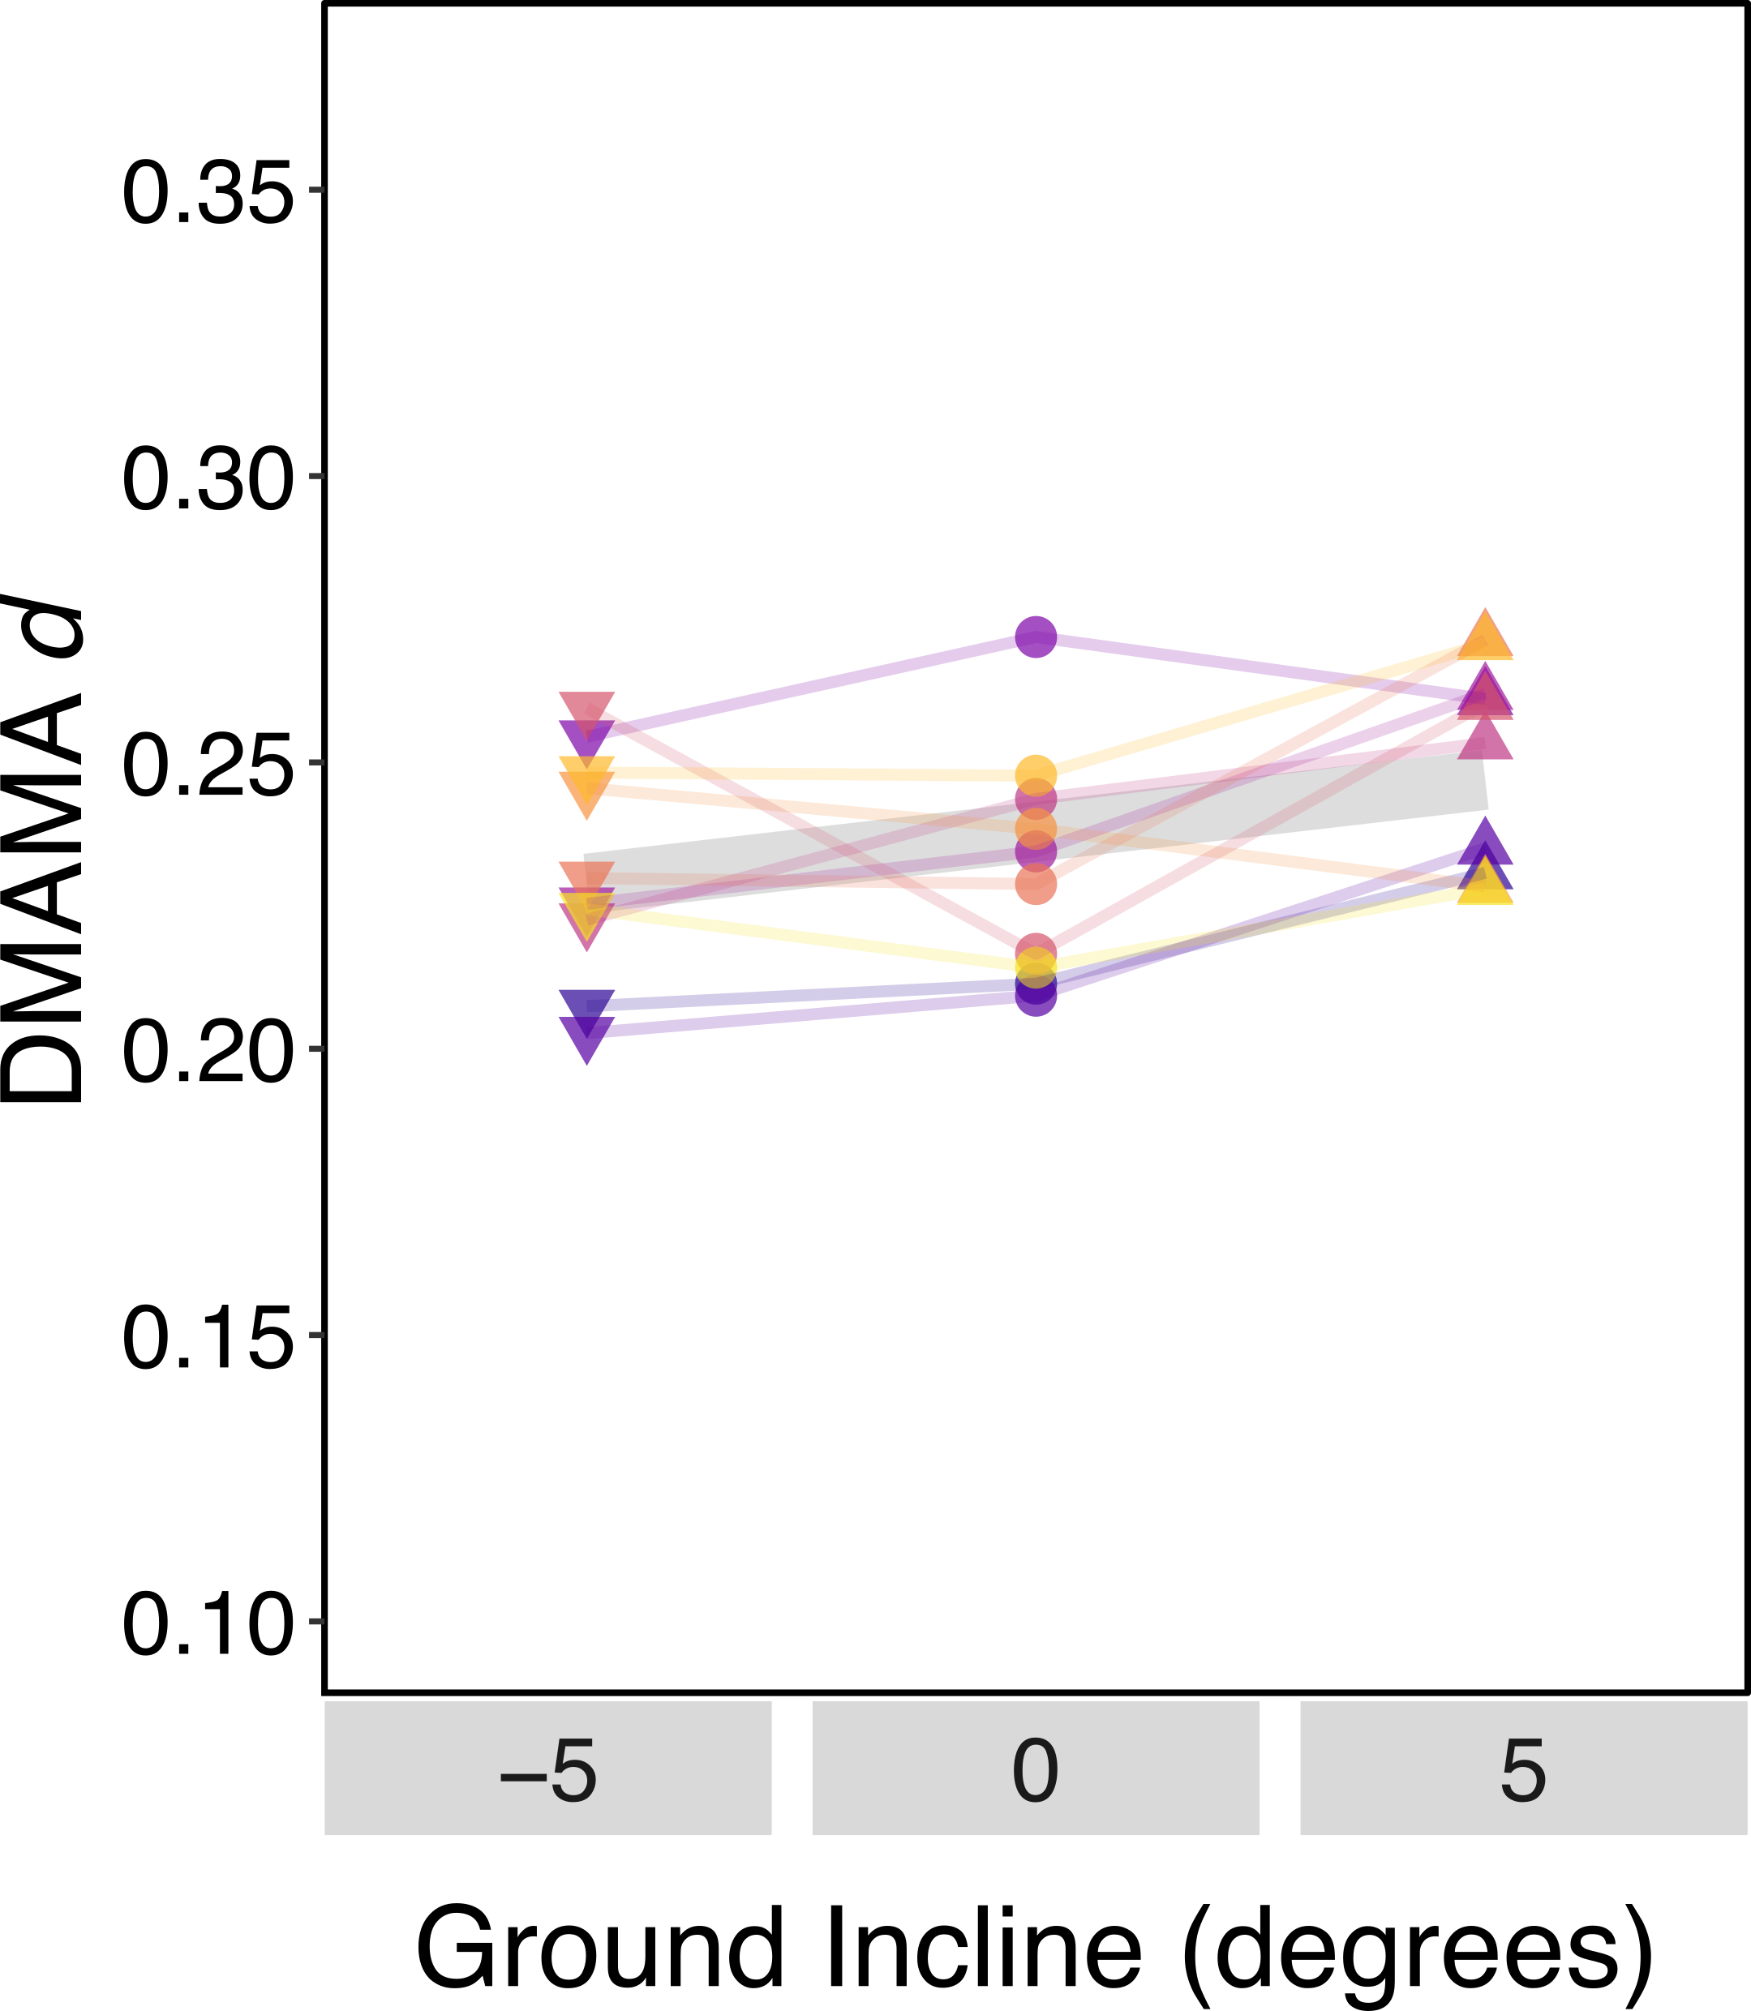
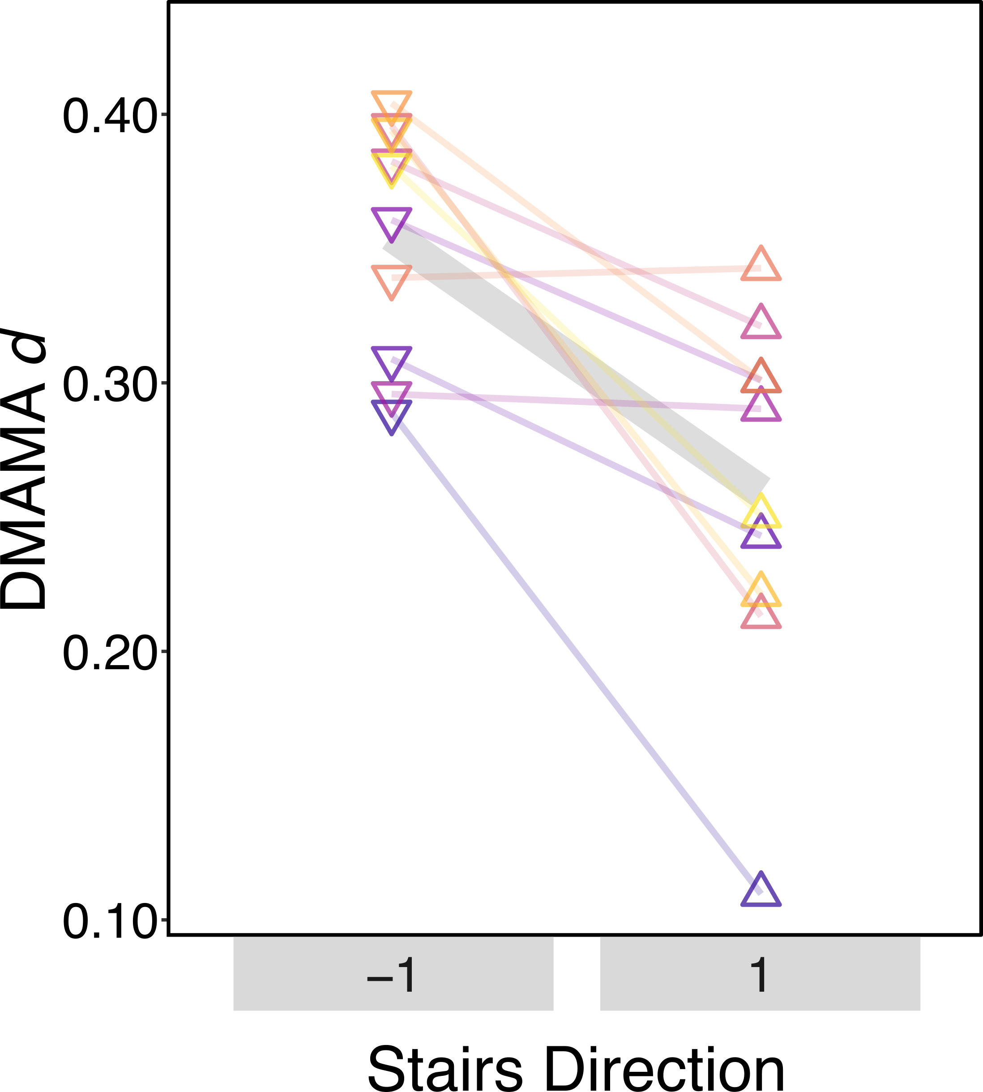
Key Findings
Notes:
Here is what we found: when walking at different speeds we saw DMAMA decrease as walking speed increased, that is it moves towards the heel as walking speed increased.
When walking on ramps DMAMA moved forward as ground incline increased suggesting a more forefooted walk.
And in stairs, when going down stairs DMAMA was significantly higher, and lower when going up stairs.

Slide 7
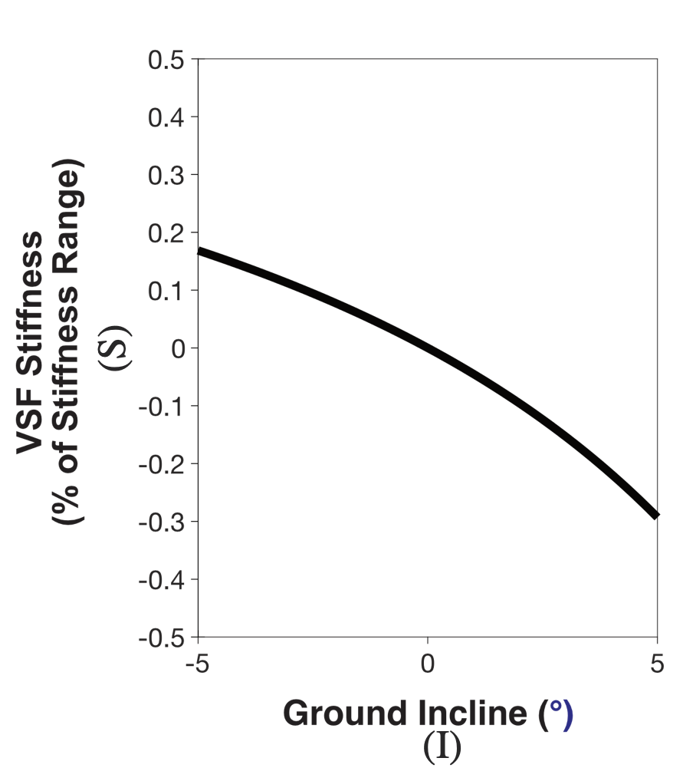
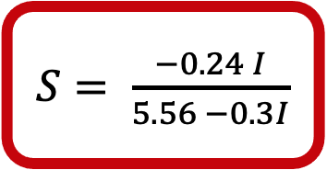
Application & Future Work
Combine with previous work:
Biomimetic Prosthetic Ankle Control Law
$S= \frac{−0.24 I}{5.56 −0.3I}$
With VSF:
DMAMA moved closer further from the heel as incline and stiffness increased.
Notes:
Moving forward we are seeking to combine what we’ve learned with previous work to implement and test a biomimetic control law. In our previous work we observed changes in DMAMA over different terrains and forefoot stiffnesses when wearing the VSF, variable stiffness foot. Combining that with the findings of the unimpaired study we start to get an idea of a control law. This graph shows the degree to which the VSF stiffness should decrease as ground incline increases in order to match the unimpaired biomechanics.
As future work we would like to implement this control law and find out if it in fact improves the user’s experience.

Slide 8
Main Takeaways
DMAMA is sensitive to walking speed, ground slope and stair ambulation in unimpaired individuals.
DMAMA is a promising measure to control semi-active (single-adjustment-per-stride) prostheses.
Thank you!
Acknowledgements
Funding from DOD (W81XWH1920024, W81XWH1710427)

Slide 10
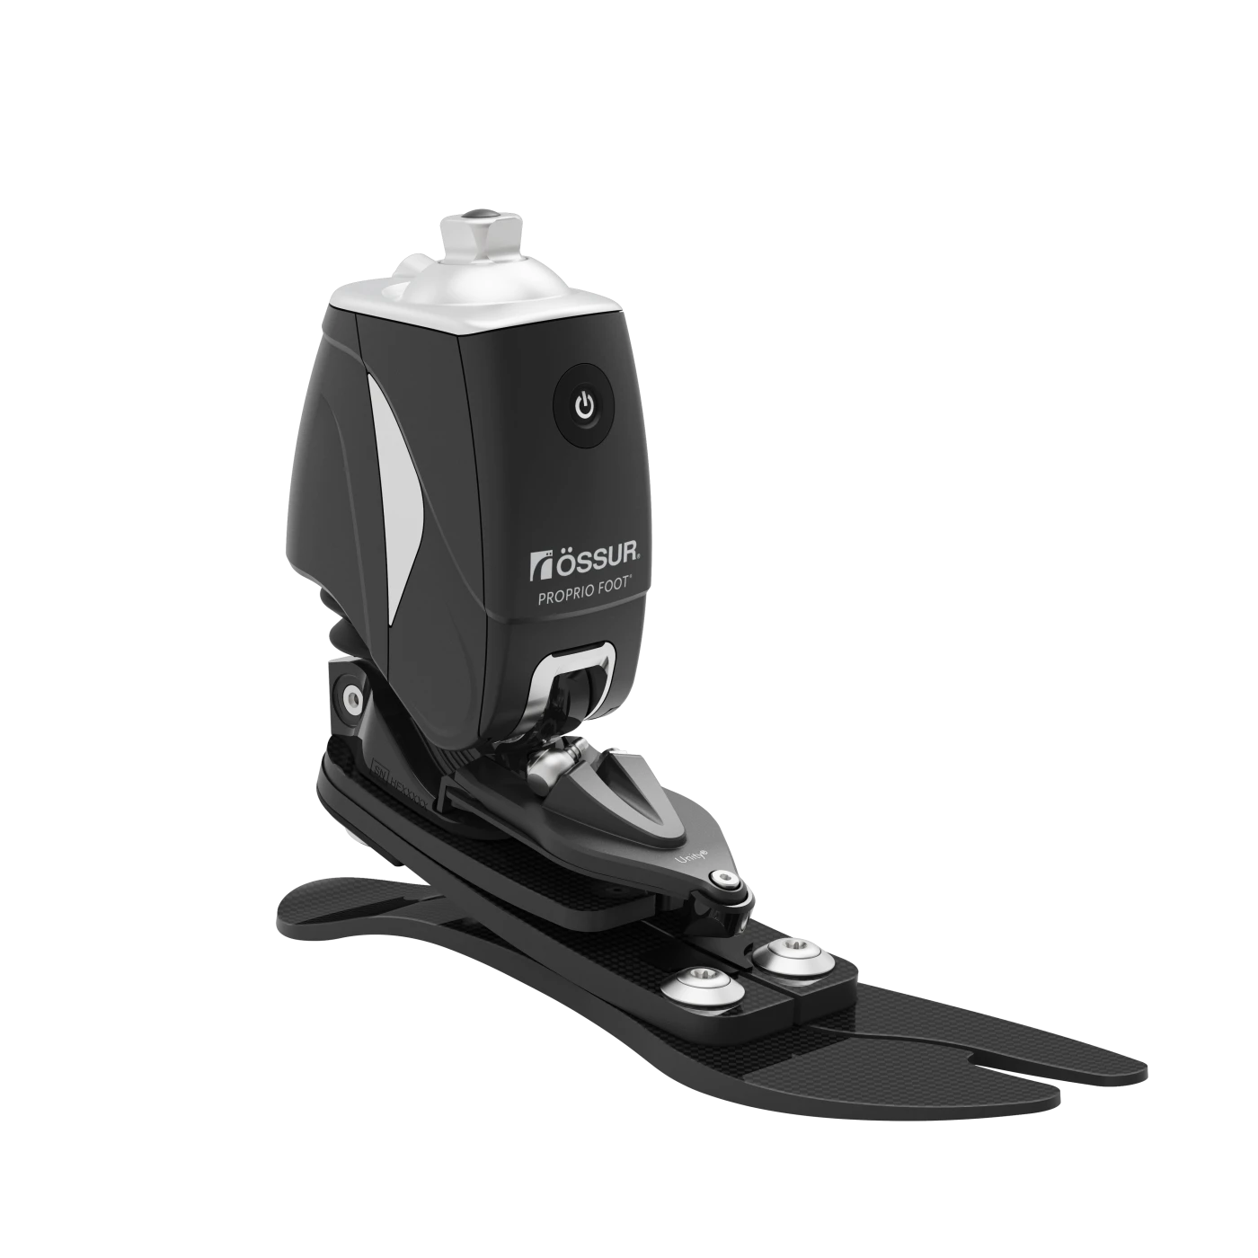
Prosthetic Foot Control
Passive
Semi-Active
Active
(fully robotic)
adjusts stiffness once per stride
Vari-Flex® by Össur
Variable Stiffness Foot (VSF)
Proprio Foot® by Össur
Wanted: Summative, once-per-stride target control measure
Notes:
Prosthetic feet can be categorized into three main types: Passive which have no electronic components and essentially work as a spring, active which are fully robotic and have the ability provide energy such as push off and finally, semi-active prostheses. In order to have lowered complexity and weight these prostheses only adjust once per stride. For example, here we the variable stiffness foot adjusts forefoot stiffness once per stride when the foot is in the air.

Slide 11
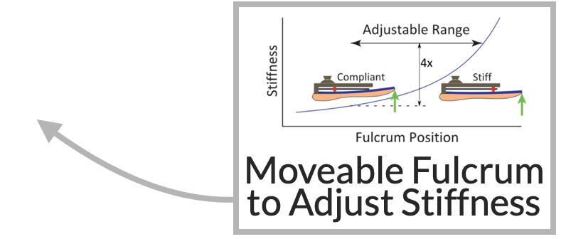
Passive
Semi-Active
Active
(fully robotic)

Slide 12






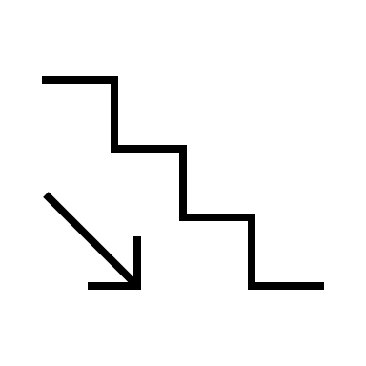
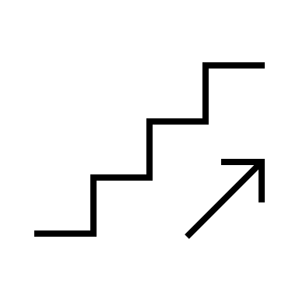

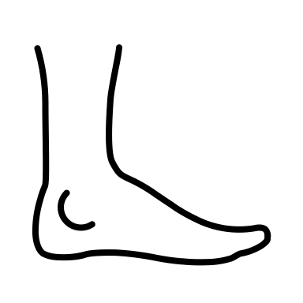



Data

